Slide 1
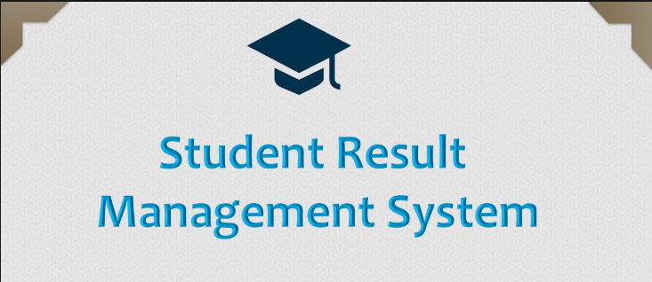
Project in Programming In C
Name – Anurag Chauhan
Sap – 590027717
Batch – 60
Course – Programming in C
Submitted to – Prashant Trivedi

Slide 2
ABOUT
This project is a simple Result Management System made using the C programming language.
The aim of the project is to store student details in a text file and allow the user to add and display student records.
The project uses basic concepts of C such as structures, functions, file handling, and header files. It is a project to understand how data can be stored and retrieved.

Slide 3
1)Problem Definition
In schools and colleges, storing student information is important.
Unlike our colleges , there are many schools and college that rely on manually storing data
Using a computer program makes the work easier for everyone .
The solution is to create a program that can:
Add a student record
Display all student records
Save the data permanently in a file
Easy data access

Slide 4

System Design
Algorithm for Add Student:
Ask the user to enter student details.
Store the details in a struct.
Append the struct to the student array.
Save the updated array into the file.
Algorithm for Display Students:
Open the student file.
Read data line by line.
Convert each line into a struct.
Print all details.

Slide 5
Here we can make different files for the program writing so the
Code is more readale , easy to understand and debug
Files:
  main.c → menu
  student.c → functions
  student.h → struct + prototypes
  data/students.txt → storage

Slide 6

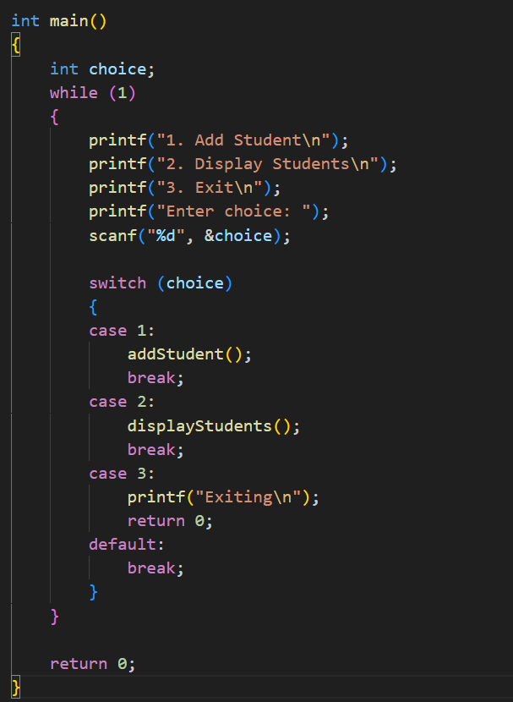
main.c
I/O library
Brings in the functions from student .h
While loop for printing menu for the user .
Scanf stores it in choice
Using switch case there will be 3 option for the user
1)Add student
2)Display the records
3)Exit the system

Slide 7

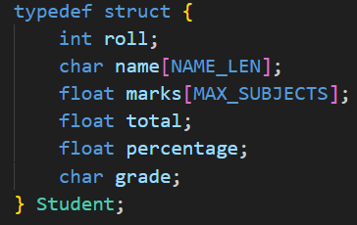
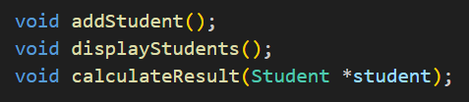
student.h file
maximum number of subjects per student (5
max characters reserved for name (40).
roll – store roll number in integer form
Name – stores char array for student (only 40 characters )
Marsk- stores marks of the students
Total – sum of marks
Percentage- total/no. of subjects(max_subjects)
Grade – single character grade – A,B,C,D,F
Student; - holds one student data
This calls the rest of the fucntions
Addstudent-read student input and stores it
Displaystudent-prints stored students
Calculateresult-fills total , percentage ,grade for given student

Slide 8
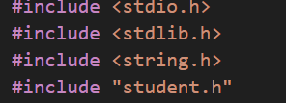
These are just headers used here in student.c
Student.c file
1)Brings in standard I/O declarations
2)#include”student.h”-to import student.h prototypes
When compiled , file path will be replaced with string ../data/students.txt

Slide 9
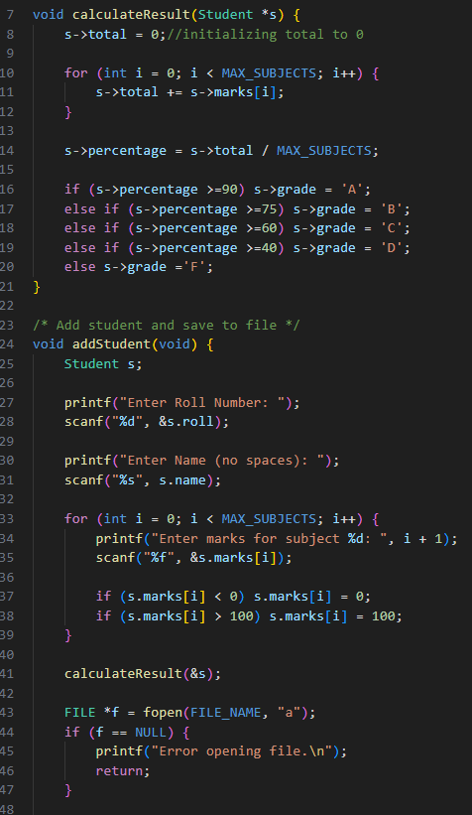
1)Functions used
-Void calculateresult
-void addstudent
2)Loops used -- if else ,for
3) Simple input out library is used for taking input and providing output
4)File handling
5) Pointers used
6)Use s-> is same as using (*s).total

Slide 10
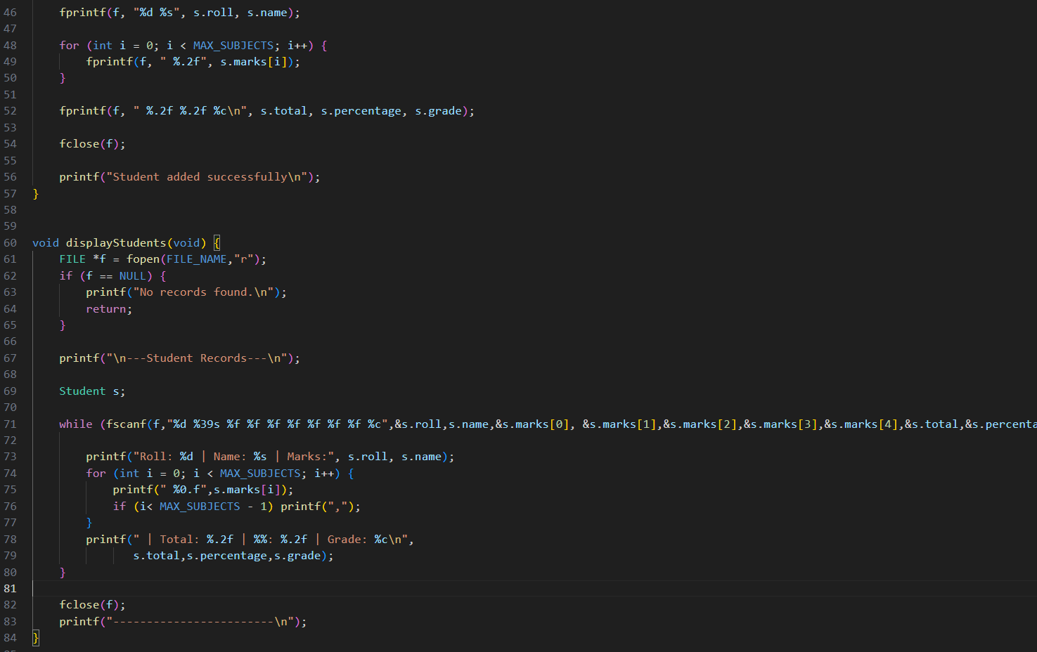
How program works
7)calculateResult sums the marks, sets total, computes average as percentage, then assigns a grade by checking percentage . It modifies the passed Student via pointer so the caller gets the updated fields.

Slide 11
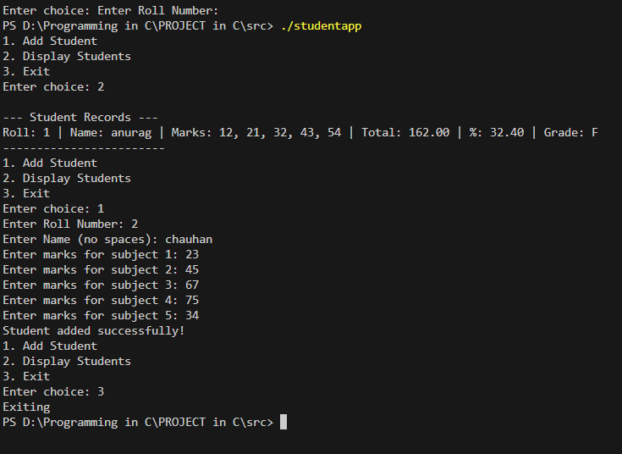
Code running
Input – type 2 will displays all the student details
(here only one student data was stored )
Input – type 1 add student information
Input – 3 exits the program

Slide 12
4) Novelty / Contributions
This solution unique because it not just store the student data of marks ,roll number , name , it also calculate percentage and grade.
The results and the data that is stored is permanent and easily accessible
The report of the data is generated a structured manner.
IMPROVMENTS
To generate overall class topper
Export results into a pdf
Password protected data base

Slide 13
References
Lecture notes by Prashant sir
Online learning –Bro code, college wallah
Online tools for learning -geek for geeks notes of c

Slide 14
Thank you ..

